Slide 1
Dynamic Obstacle Avoidance & Path Planning in a Hospital Environment
RBE 550 - Motion Planning
Project Presentation
Girivaasan Chandrasekaran, Dominic Ferro, and Thabsheer Machingal
https://github.com/Dom-Ferro/RBE550FinalProject.git
https://youtu.be/xnaif61IXbc

Slide 2
Problem Description
Safe and efficient mobility of mobile robots are crucial in hospital settings
Dynamic, Complex environments with obstacles (equipment, staff, patients)
Limitations of conventional path planning techniques (RRT, PRM)
Assumptions about static impediments
Inability to manage non-holonomic restrictions
Notes:
The safe and efficient mobility of mobile robots in a hospital environment is crucial for the prompt delivery of supplies, equipment, and medication. Hospital surroundings, however, are dynamic and complicated, with obstacles like equipments, medical staff, and patients. Due to their assumptions about static impediments and inability to manage non-holonomic restrictions, conventional path planning techniques like Rapidly-exploring Random Trees (RRT) or Probabilistic Roadmap (PRM) may not be suitable for such situations. To address the dynamic and changing nature of hospital environments while taking into account the non-holonomic limits of mobile robots, path planning algorithms efficient in dynamic environments must be implemented.
To overcome these limitations, it is crucial to implement path planning algorithm that are efficient in dynamic environments and can take into account the non-holonomic restrictions of mobile robots. We aim to investigate different path planning algorithms that are suited for the complex and dynamic nature of the hospital environments. We will analyze their performance and identify the scenarios in which each method is most effective.
We believe that by comparing and contrasting each algorithm, we can understand their strengths and limitations. Ultimately, the results of this project may contribute to the development of safer, more efficient, and effective mobile robots for use in hospital and other complex environments.

Slide 3
Problem Statement
We propose testing three advanced path planning and obstacle avoidance algorithms, and compare and contrast algorithm strengths and limitations in order to contribute to the development of safer and more efficient mobile robots in hospital and complex environments
Notes:
The safe and efficient mobility of mobile robots in a hospital environment is crucial for the prompt delivery of supplies, equipment, and medication. Hospital surroundings, however, are dynamic and complicated, with obstacles like equipments, medical staff, and patients. Due to their assumptions about static impediments and inability to manage non-holonomic restrictions, conventional path planning techniques like Rapidly-exploring Random Trees (RRT) or Probabilistic Roadmap (PRM) may not be suitable for such situations. To address the dynamic and changing nature of hospital environments while taking into account the non-holonomic limits of mobile robots, path planning algorithms efficient in dynamic environments must be implemented.
To overcome these limitations, it is crucial to implement path planning algorithm that are efficient in dynamic environments and can take into account the non-holonomic restrictions of mobile robots. We aim to investigate different path planning algorithms that are suited for the complex and dynamic nature of the hospital environments. We will analyze their performance and identify the scenarios in which each method is most effective.
We believe that by comparing and contrasting each algorithm, we can understand their strengths and limitations. Ultimately, the results of this project may contribute to the development of safer, more efficient, and effective mobile robots for use in hospital and other complex environments.

Slide 4
Application impacts
Improved efficiency : Enhanced navigation and timely delivery of supplies, equipment and medication.
Increased safety: Minimal risk of collision involving patients, staff, and equipment.
Cost efficiency: Reduced need for manual transport, potential for optimized resource allocation.
Adaptability to changing conditions: Ability to respond to dynamic environments and adjust path planning accordingly.
Notes:
Mobile robots can move more efficiently and avoid congestion in high-traffic areas by dynamically planning their paths. This can result in faster delivery of supplies and equipment, which can have a positive impact on patient outcomes.
Dynamic path planning algorithms can help mobile robots avoid collisions with people, equipment, and other obstacles in the hospital environment. This can reduce the risk of accidents and injuries, ensuring a safer environment for both patients and medical staff.
The use of mobile robots for tasks such as delivery of supplies and equipment can reduce the workload of medical staff, allowing them to focus on more critical tasks. This can result in cost savings for hospitals by reducing the need for additional staffing.
Hospital environments are constantly changing, with new obstacles and challenges arising throughout the day. Dynamic path planning algorithms can adapt to these changes and generate new paths accordingly, ensuring that mobile robots can continue to operate safely and efficiently.

Slide 5
Related work
D*
Koenig et. al. (2005)[1] describe a computationally lighter version of D* (D* light) that creates a path with the same optimality of D*
DWA+Splines
Solving foresighted navigation is essential to introduction robots in collaborative environments like hospitals[2]. This paper introduces a dynamic collision model that is capable of predicting future collisions.
This article [3] proposes a novel approach to motion planning and navigation of mobile robots that combines spline-based motion planning with Dynamic Window Approach for velocity control. The authors demonstrate the ability of the algorithm for improved motion control.
The authors of this[4] paper proposes an improved dynamic window approach, that is based on the robot dynamics model, reducing computational complexity and improves real-time performance.

Slide 6
Related Work
Hybrid Potential Based Probabilistic Roadmap Algorithm (HPPRM)
HPPRM combines the strengths of traditional and probabilistic Roadmaps with the Artificial potential field method to address the narrow passage problem and improve the efficiency and computation of the sampling-based path planning. This algorithm[5] showcases a success rate of 95% for both global and local planning.
This paper[6] introduces an improved APF based PRM, that can improve the efficiency of planning in narrow spaces. A partition-based sampling strategy is developed to improve the number of sampling points in dense obstacle areas while maintaining a uniform distribution. Additionally, critical points are added using a new eight-directional detection method, which effectively improves the success rate of path planning.
Another method to address planning in narrow spaces[7], where a biased sampling scheme is used to increase the distribution of nodes in narrow regions of the free space.

Slide 7
Proposed method
For the given problem (hospital environment with obstacles) we propose three solutions/motion planning methods.
D* : An Incremental search algorithm that is able to efficiently re-plans a path in a graph when encountering unknown changes
DWA+Splines: Real-time path planning and obstacle avoidance algorithm
HPPRM: Generate collision-free paths for robots in complex environments with obstacles.
Our goal is to investigate and present unique benefits of each algorithm for the given problem

Slide 8
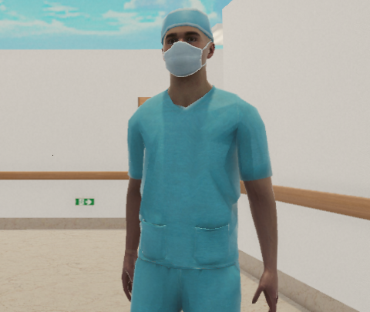
Experiment
Tasks
We will be moving the robot from one room in the hospital to another with various stages of obstacles, the stages will be:
Known static obstacles
Unknown static obstacles
Known static obstacles with dynamic obstacles
Unknown static obstacles with dynamic obstacles
Insert screenshot of simulation with person walking
Notes:
Dom -> experiment in report
We will be moving the robot from one room in the hospital to another with various stages of obstacles the stages will be:
Known static obstacles
Unknown static obstacles
Known static obstacles with dynamic obstacles
Unknown static obstacles with dynamic obstacles

Slide 9
Experiment
Evaluation
We will be comparing and contrasting different motion planning algorithms on following performance metrics. The metrics we will consider in our comparison are:
Optimality: Quality of generated path, minimal distance and runtime.
Completeness: Ability to find a solution when one exists.
Safety: Ensuring minimal number of collision with obstacles, patients, and staff.
Computational Efficiency: Low processing time and memory usage.
Robustness: Adaptability of environment changes and uncertainties.
Notes:
Comment - specify measurement (metric) for the path length with respect to euclidean distance, runtime for motion planning, consider metrics. If you run this multiple times for the same task you may also consider the variety of performance for example it may have very good runtime once and bad another is not preferred. Quasi-random sampling we care about the variety of sampling performance.
Optimality:
Time to complete the generated path, and length of the path
Completeness:
How many times does robot find a path when one exists
Safety:
Number of Collisions (should be 0)
Computational Efficiency:
Space and Time complexity.
Robustness:
How does the robot handle different scenarios like changes in obstacle number, type, shape and speed.

Slide 10
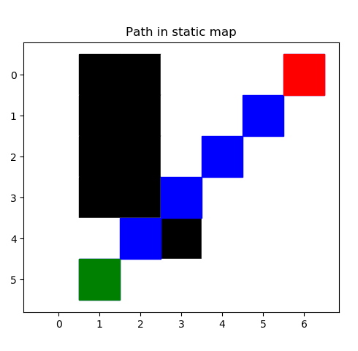
D*
Toy Problem seen on the right contains
Static known obstacles
Unknown obstacles
Dynamic obstacles
Still able to find an optimal path!
Notes:
Here we see the toy problem for D* . This is a super simplified map, only 6x6, many of you should recognize it because it is a variation of the map used during the hw implementation. Some changes to the map include some unknown static and unknown dynamic obstacles. D* precalculates the gradient towards the optimal path a the beginning of path planning, so as the robot moves along the path and encounters these obstacles it is able to quickly and efficiently rewire the path. Meaning even with unknown nad dynamic obstacles, it is stil bale to find a path.

Slide 11
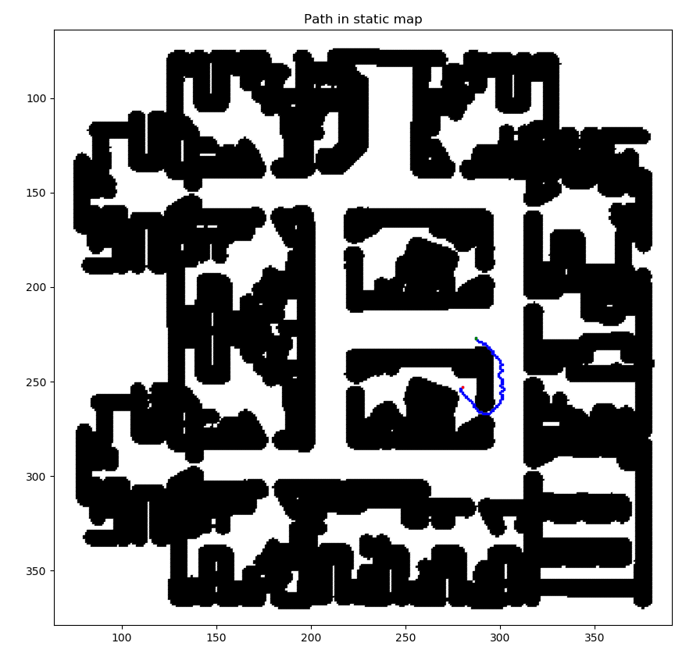
D*
Moving towards real life applications
Generated a c-space map of the Unity Hospital
Generated from a ros message
Robot starts in the same hallway it is in in Unity
Gave the robot a goal in a hospital room
Notes:
Dom
Applying the motion planning algorithm to the hospital D* was successfully able to path plan from the starting position in the main hallway into one of the hospital rooms. This map has a resolution of roughly 0.1 m per box and is the highest ratio of distance to grid square possible before the entrances of the doorways were completely covered by the c-space.

Slide 12
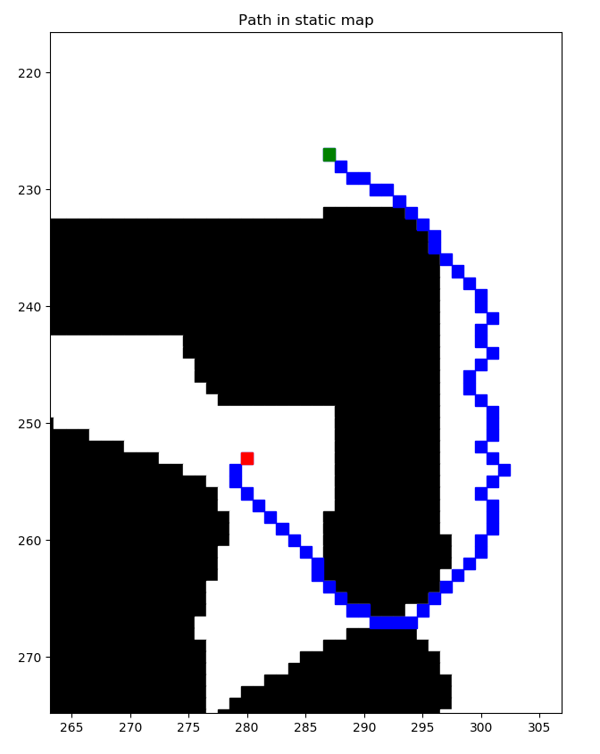
D*
Closer look at the path:
Resolution generates a very large grid
This short path has the optimal number of nodes (61)
The distance is not optimal due to the algorithm choosing diagonals over straight lines
Was able to find a path through a narrow passage (doorway)
Notes:
Dom
D* was successfully able to path plan from the starting position in the main hallway into one of the hospital rooms. This map has a resolution of roughly 0.45 m per box and is the highest ratio of distance to grid square possible before the entrances of the doorways were completely covered by the c-space.
As you can see in this zoomed in picture of the path, it is not fully optimal. While D* is capable of optimality when utilized in a large area such as this big hospital, the computational cost add up and can cause it to make mistakes. Even though it does wiggle towards the doorway after going around the corner, each square does bring it closer to the goal, the optimality of the path could be improved by adding a higher cost for moving diagonally to try and discourage this behavior. As it stands there are so many other grid spaces that add to the heuristic value of far away nodes, that the additional cost of moving diagonal is negligible.
This path shown here can be passed to ROS and therefore Unity in a ROS Path message type, from there the move_base local planner would be able to handle moving the robot along this path. As of now, the move_base requires a node written in c to be a plugin for the global planner and does not allow for the local planner ot just accept ros messages, so a different local path planner was created.

Slide 13

Integrating ROS and Unity
Notes:
Dom:
On the left half of the video you can see the birds eye view of the unity simulation as well as the map in RVIZ. The rviz map has the map created from gmpping as well as the grid, discretized map overlaid on it. Here the occupancy grid from move_base has a resolution of 0.05 m and the discretized grid utilized by d* is 9 times that resolution, for a resolution of 0.45m. In the previous slides the map had a resolution 2 times the resolution, or 0.1m and was able to utilize a c-space. In this map, the resolution is not fine enough to have a valid c-space. The decrease in resolution is due to the computing limitations of my laptop. At 2 times resolution it took over 3 hours to calculate the values for all of the nodes and generate a path. When hooked into rviz the robot odometry would shift every 2 hours and reset the calculations. To keep my sanity and allow for calculations a smaller size map was utilized. Unfortunately the computation limitations of my computer reared its head again once the robot started to move. The ros messages started to build up and about halfway down the hallway the control inputs to the robot started lag behind real time and crash into walls. The d* path planner was only utilized as a global path planner and a crude local path planner was utilized to get the robot to move. While my computer was limiting creating and debugging a more complex method, all implementations of d* have to be aware that this method will only be as good as the local path planner. To stay within the computing limitations the toy problem was instead expanded upon.

Slide 14
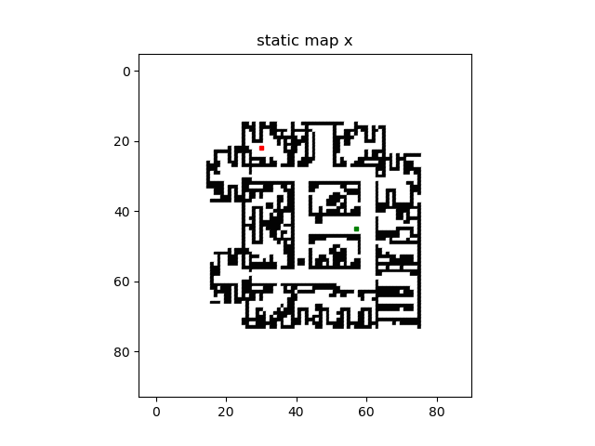
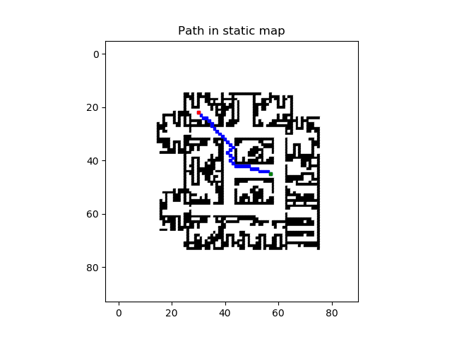
D* in the Hospital
Obstacles over time
Robot path
Notes:
Utilizing the map of the hospital the robot utilized a known static map that consisted the walls and the generic obstacles. On the left is the actual map, including an unknown static obstacles and several unknown dynamic obstacles. As you can see on the right, the path planning was successfully able to navigate around the static obstacle and avoid the dynamic obstacles. The robot can only see 1 meter around it, or 2 blocks, so when it moves out of range of the dynamic obstacles it assumes there is still an obstacle there. This can be seen at the top left as it moves through the doorway to the goal.

Slide 15
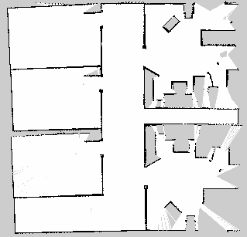
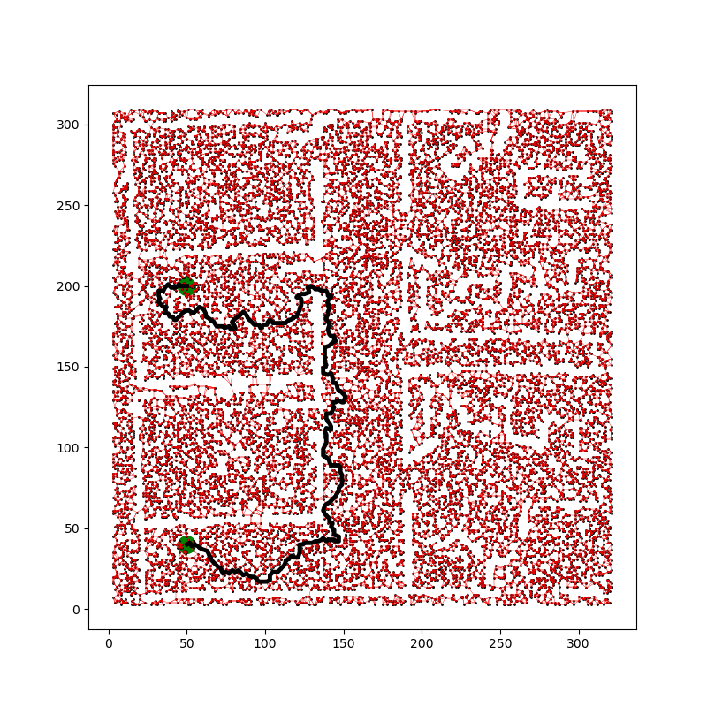
HPPRM:
The algorithm was tested with 2D maps with different types of static obstacles.
Obstacles, being thick blocks in the map is detected better.
The sample hospital map provided in the Gopher-ROS-Unity repository was tested, but the algorithm failed to detect the thin walls as obstacles in the map and planned a path through them.
The repulsion range of the APF was tuned and the obstacles made more sensitive so that they were detected efficiently.

Slide 16
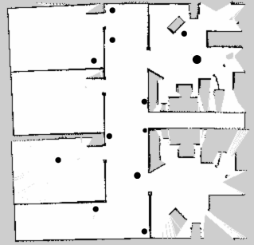
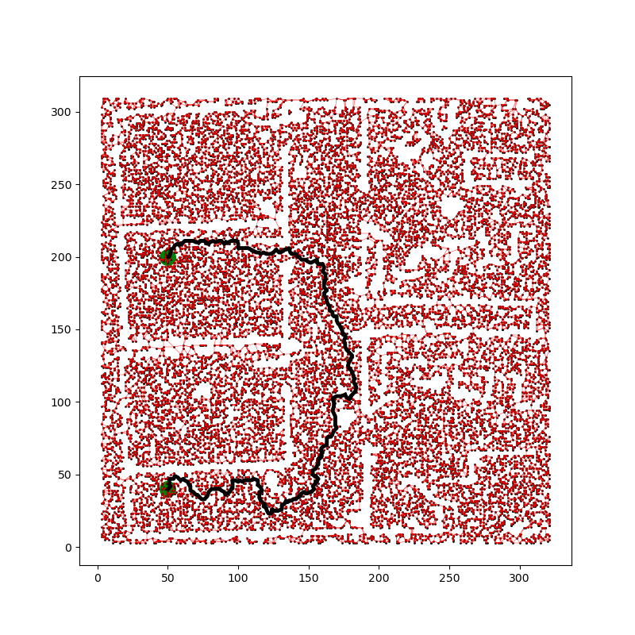
HPPRM:
The hospital map was added with a few circular obstacles and then too the algorithm was able to find a path to its goal. The circular obstacles here are assumed to be humans in the hospital area.

Slide 17
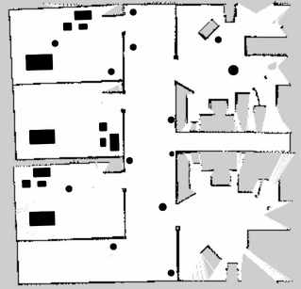
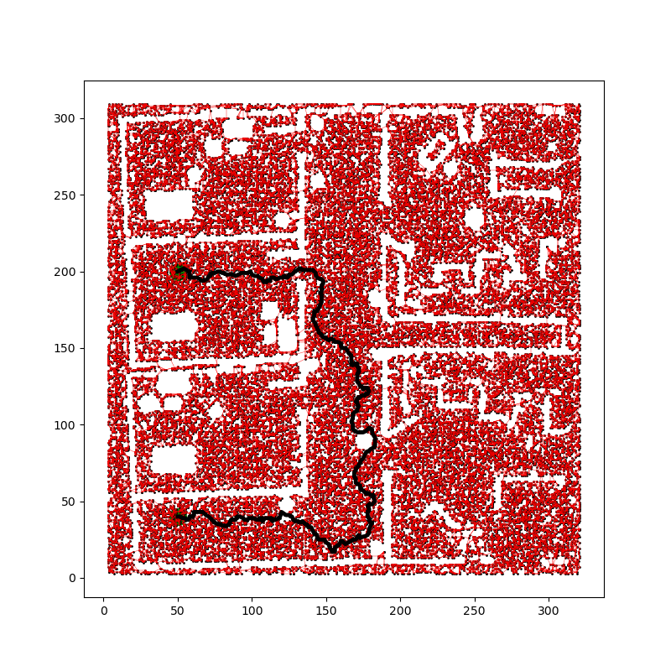
HPPRM:
The hospital map was modified again by adding rectangular obstacles that represents the hospital bed and couches in the rooms. Though there were immense number of sampling points that resulted in higher computational time, a feasible path was generated.

Slide 18
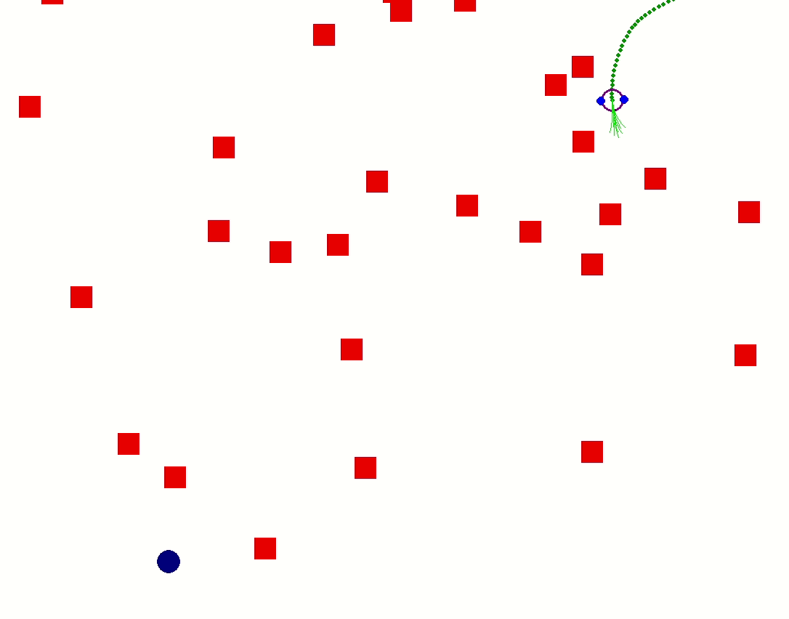
Spline based DWA
Local Planning: based on local environment and current states
Robot Dynamics: Considers kinematic and dynamic constraints
Admissible Velocities: Generates velocities that are safe and reachable
Cost Function: forward heading, velocity, and distance from obstacles
Best Velocity Selection: Best velocity that maximizes cost
Real-time Obstacle Avoidance: Designed for reactive planning
Local Minima: The robot can stuck in local minima
Integration with Global Planner: DWA is often combined with global planning
Trajectory generation: Cubic splines or B-splines for trajectory generation
Notes:
Outline of Dynamic window approach
Local Planning: DWA is a local planner that computes control inputs based on the robot's current state and local environment.
Robot Dynamics: DWA considers the robot's kinematic and dynamic constraints when generating possible velocities.
Admissible Velocities: DWA generates a set of admissible velocities within the robot's dynamic window, ensuring the velocities are reachable and safe.
Cost Function: DWA evaluates each admissible velocity against a cost function, which typically considers factors like forward heading, velocity, and distance from obstacles.
Best Velocity Selection: DWA selects the best velocity that maximizes the cost function, aiming for a safe and efficient trajectory.
Real-time Obstacle Avoidance: DWA is designed for real-time obstacle avoidance and trajectory generation, making it suitable for dynamic environments.
Local Minima: DWA can get stuck in local minima or fail to navigate through complex obstacle configurations.
Integration with Global Planner: To improve performance, DWA is often combined with global planning algorithms like A* or PRM, which provide a global path to guide the robot towards its goal.
Trajectory generation: We used splines for generating smooth trajectory. We have tried cubic and Bsplines for trajectory generation. They both yielded almost identical results.
Using splines made smoother trajectories
Talk about the figure

Slide 19
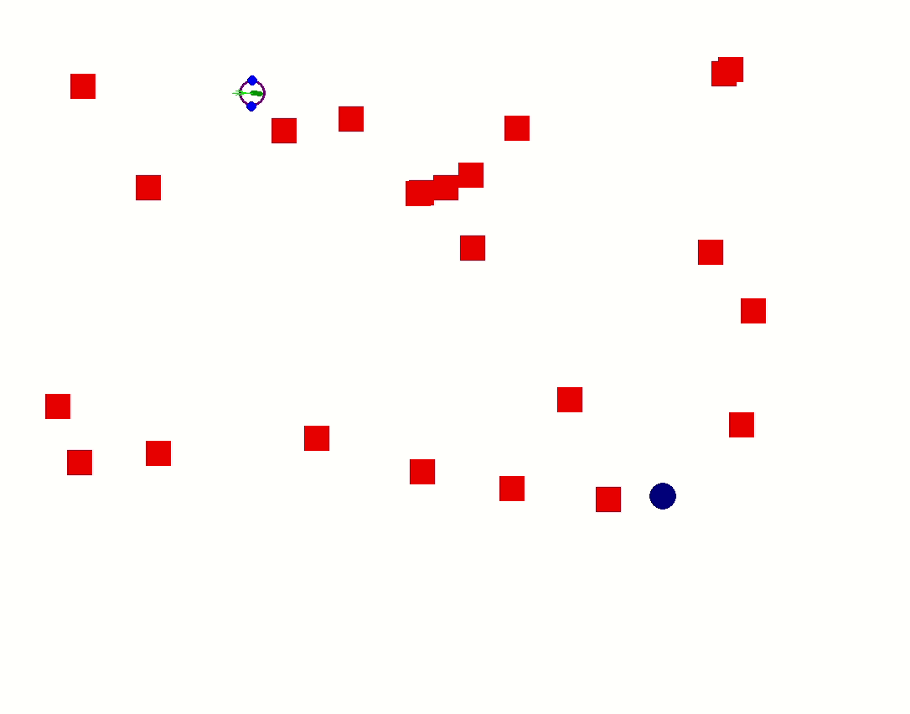
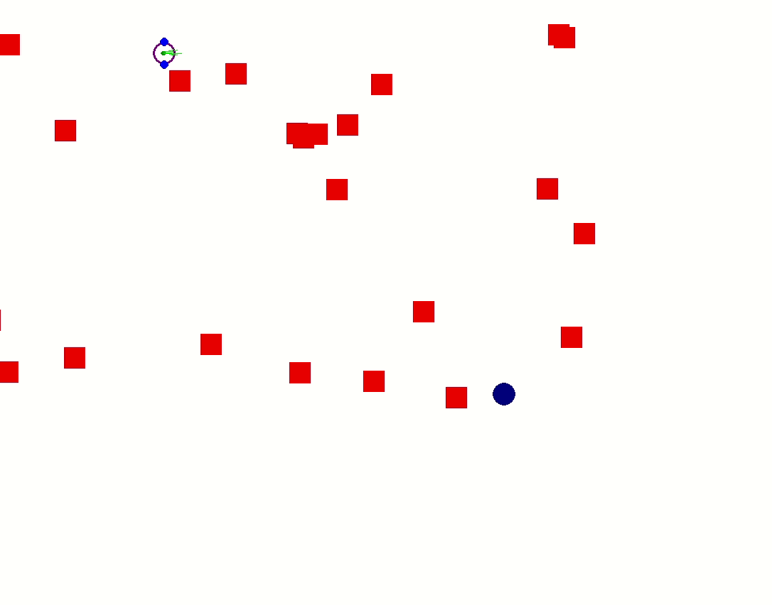
Spline based DWA
Real-time Planning for static and dynamic obstacles
Performs better with dynamic obstacles
Predict the movement of obstacle in collision
Splines generated smoother trajectories
Tested with B-splines and Cubic splines
Static Obstacles
Dynamic Obstacles
Notes:
DWA can be used as real-time planner
It can be used for both static and dynamic obstacles
As you can see the algorithm can predict the movement of obstacle in collision, either towards the robot, or away from it. It stops at an obstacles and replans at each dynamic window.
Trajectories generated by cubic/ bsplines are smoother

Slide 20
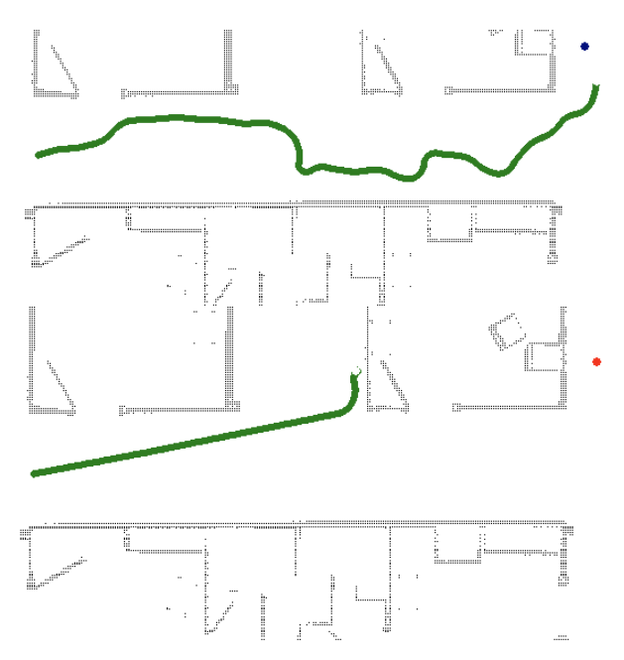
Spline based DWA
Reactive Planner
Cannot be used as a complete planner without a global planner
Simulation in Hospital env
Notes:
DWA is more useful as a reactive planner - a real-time obstacle avoidance algorithm,
It is not complete without a global planner.
The figure demonstrate that the DWA alone will not be sufficient. But when implemented with a global planner it does find a path.
The figure of the right is from the simulation in Hospital environment rendered using pygame.

Slide 21
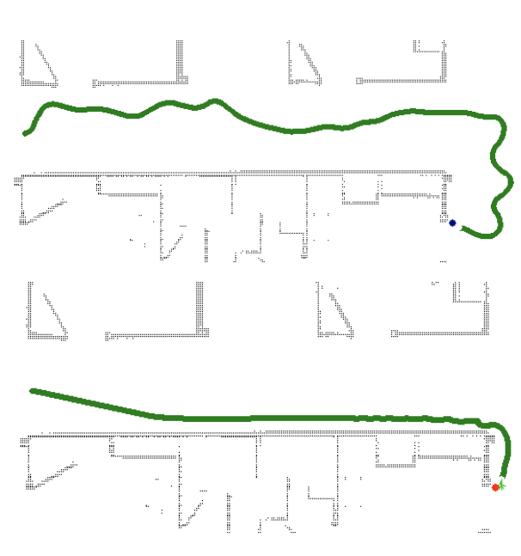
Spline based DWA
(i) With global planner(RRT)
(ii) Without a global planner
Notes:
This figure demonstrate that the DWA Aalgorithm alone might find a path, but its not guaranteed
Whether or not the algorithm can reach to goal depends on the environment and the distribution of obstacles and the objective function.

Slide 22
Quantitative Evaluation: Methodology
Each algorithm tested for the same test cases(hospital env, start, and goal) and evaluated Optimality and Completeness
Optimality: Path length in meters for a test case (start = (4, 15), goal = (17, 20)).
Completeness: Number of successful planning out of 10 test cases.
Safety: Average number of collisions out of 10 test cases.
Execution Time: The time taken by each algorithm to find a solution.
Robustness: out of the 4 different environments (static, unknown static, dynamic, unknown dynamic) how many it could find a path in.
Notes:
We compared the performance of each algorithm quantitatively, and these are the metrics we used to compare
PLease note that the DWA is local planner is different from other two algorithm, hence we are comparing with and without a global planner
In many cases a quantitative comparison would difficult as some of them are local planner and metrics like optimality does not apply but we can evaluate the performance quantitatively, which is given in the next slide
We use comparison of the distance or path length in metres to find optimality of the algorithm, The test is conducted for the same start and end points in the graph
We take a planning complete when it successfully find a path in a reasonable time (there was no hard-time limit). For 10 test cases.
Safety is defined as the average number of collisions in 10 test cases
The next criteria is the time taken by each algorithm
Robustness is measures the number of tests it passed in (static, dynamic, unknown static, unknown dynamic env)

Slide 23
Quantitative Evaluation - Results
Evaluation Criteria | D* | HPPRM | Splines+DWA without global planner | Splines+DWA with global planner(RRT)
Optimality | 6.3 ±0.38m | 7.6±0.2m | Not applicable | 8.1±0.2m
Completeness | 10 | 10 | 4 | 9
Safety | 1 | 2 | 0 | 0
Execution time | Depends on resolution | Increases as the complexity of the obstacles and graph increases | 1.5 seconds, almost constant all the time
Robustness | 4 | 2 | 4 (for toy problem) | 4
Notes:
Evaluation metrics and their definition are given in the slide 22
All the evaluations were made on similar test case. I.e. Same start and endpoint on the hospital environment.
The results are given the table
Please note that the measurement for optimality is provided with a standard deviation for 10 test cases
As you can see the D* is the most optimal of all. It can find the shortest path out of all three algorithms in the given environment.
Most the algorithms are complete, DWA without a global planner is just a reactive planner. It cannot evaluated for completeness.
The number of Coliision in 10 tests(safety), execution time and robustness (number of test passed) is given in th table.
For HPPRM, we hav not tested it for dynamic obstacle, hence it is 2.

Slide 24
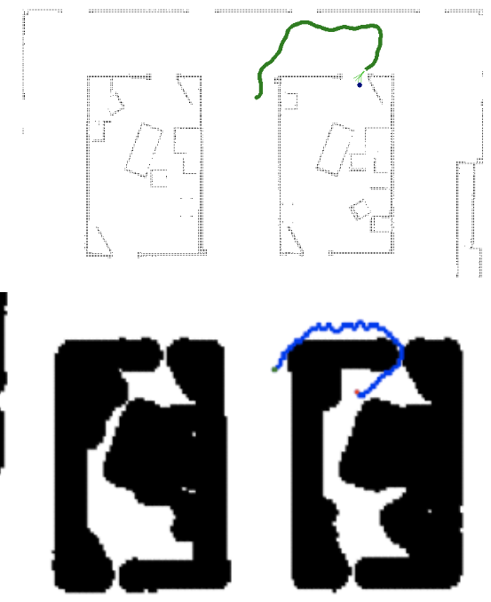
Limitations
D* Algorithm | HPPRM | Splines+DWA
Computationally expensive | High computational time | Lower computation time
Discretizing the workspace can decrease accuracy | Sampled space increase with more complex environments that result in expensive computation | Directly work with velocity space
 |  | Hyperparameter optimization is difficult
 |  | DWA is highly dependent on the global planner for optimality and completeness
Notes:
For Limitations,
D* and HPPRM is computationally expensive.
Descritizing into a grid actually decrease the accuracy for d*
HPPRM takes longer to converge or find a path. The complexity is dependent on the number of nodes
DWA on the other hand is faster and cheaper, since it is a local planner
DWA work directly in the velocity space, which helps in generating dafer paths.
One down side of DWA is that it needs the hyperparameters to be tuned
DWA is highly dependent on the path generated by the global planner. In the right image, the bottom is D* and the one above uses RRT as global planner for DWA.
It finds a path that might not be optimal

Slide 25
Results and Discussion
Criteria | D* Algorithm | HPPRM | Spline based DWA
Optimality | Winding paths, in need of smoothing | Irregular paths, need to be smoothened | Not optimal(local planner)
Completeness | Dependent on map resolution | Feasible path generated every time during testing | Not complete on its own
Safety | Safe in toy problem, depends on local planner in reality | Safe path without encountering obstacles in hospital environment | Generates safe and admissible trajectories
Computational Efficiency | Comparatively inefficient | Inefficient, longer compute | Efficient, suitable for real-time planning
Robustness | Efficient at recalculating path, avoiding unknown static and dynamic obstacles | Work very well with static known and unknown obstacles | Work well in complex Dynamic environment
Notes:
-In conclusion, D* was most optimal of all three algorithms, HPPRM was optimal too. generated paths that further needed smoothening,
- DWA as local planner cannot be evaluated for optimality.
- D* algo was complete and we noticed that it depended a lot on the resolution of the map.
- HPPRM was complete, it was able to find a path every time, but took longer to converge
- Safety was one evaluation criteria that we focused on. The metric we used for safety was the number of collisions in on planning. All three algos can be used for safe-
Planning, D* was safe but IRL it would need a good local planner such as DWA.
-DWA performed well with dynamic obstacles. It was able to predict the movement of obstacles towards the robot and plan accordingly.
- As a reactive planner DWA smoothened with cubic splines is promising.
- D* aND hpprm was computationally inefficient and took longer to run. But we understand that this is the case with most
Planning algos in dynamic environment.
DWA being a real-time planner was fast, it had constant computation each time since it only select a setof velocity each time and evaluate the best out of it.
The entire planning time was around 1 second.
All three algos can work in complex environments, and with known and unknown obstacles

Slide 26
Conclusion
D* is a good global planner for optimal paths in dynamic environments.
D* can plan much faster compared to other similar algorithms(A*,PRM) in dynamic environments due to the property of incremental planning.
D* is fairly optimal and complete with a good local planner.
HPPRM is suitable for navigation in narrow passages
HPPRM can be used for various types of environments, from grid based map to more complex environments.
Spline based DWA is a good real-time reactive planner. It work well with dynamic and uncertain environments.
Our goal was to implement as safe planning algorithm. Spline based DWA ensures safety by working directly in the velocity space and generating smoother trajectories.
DWA integrated with HPPRM or D* can be a choice of safe planning algorithm in a hospital floor.
Notes:
In Conclusion,
D* can be useful as an optimal planner. It is a good global planner for DWA.
D* is comparatively faster in complex environments when compared with algorithms like A* or PRM. It is particularly useful with dynamic obstacles because of the incremental planning.
IRL, D* can be combine with a good local planner such as DWA, and can be used for planning complete, optimal, and safe trajectories
Hybrid Potential based PRM is an advanced planning algorithm, that is particularly useful for navigating narrow passages, such as doors in hospitals.
HPPRM is a versatile algorithm, it can be implemented for different types of environments or maps from grids to more complex configurations (like a 6D manipulator)
Spline Based DWA is a good real-time planner especially good at dynamic obstacle avoidance, even in the presence of uncertain environments
In the end, Our goal was identify the benefits of each algorithm and understand what works when, We believe that we have presented a comprehensive study of all three algorithms.
We believe that using Global planners like D* with DWA can help in implementing safer and optimal motion planner for robots in hospitals.
Spline based DWA ensures that the trajectory generated are smooth and safe.

Slide 27
Task Division
Dominic | Thabsheer | Girivaasan
Set up Unity Environment | DWA Algorithm | APF Implementation
Created a ROS structure to connect to Unity | Spline optimization of DWA(B-spline,Cubic) | PRM Implementation
Created a CSV generator to get the maps from the Unity simulation | Global planner for DWA (PRM and RRT) | Implemented HPPRM in a 2D sample hospital map
Implemented a 2D version of D* in the hospital environment | Pygame Rendering
Implemented a D* global path planner in the ROS -Unity simulation
Notes:
This is our Task division

Slide 28
Bibliography
[1] Koenig, Sven, and Maxim Likhachev. "Fast replanning for navigation in unknown terrain." IEEE Transactions on Robotics 21, no. 3 (2005): 354-363
[2] M. Missura and M. Bennewitz, "Predictive Collision Avoidance for the Dynamic Window Approach," 2019 International Conference on Robotics and Automation (ICRA), Montreal, QC, Canada, 2019, pp. 8620-8626, doi: 10.1109/ICRA.2019.8794386.
[3] B. Demir, F. Hoeller, F. Garcia Rosas, D. Schulz and N. Goerke, "Spline-Based Robot Trajectory Generation Using the Dynamic Window Approach," 2019 Third IEEE International Conference on Robotic Computing (IRC), Naples, Italy, 2019, pp. 9-16, doi: 10.1109/IRC.2019.00011.
[4] Feng, D., Deng, L., Sun, T., Liu, H., Zhang, H., Zhao, Y. (2021). Local Path Planning Based on an Improved Dynamic Window Approach in ROS. In: Liu, Q., Liu, X., Shen, T., Qiu, X. (eds) The 10th International Conference on Computer Engineering and Networks. CENet 2020. Advances in Intelligent Systems and Computing, vol 1274. Springer, Singapore. https://doi.org/10.1007/978-981-15-8462-6_133
[5] Ankit A. Ravankar, Abhijeet A. Ravankar, Takanori Emaru, and Yukinori Kobayashi. "HPPRM: Hybrid Potential Based Probabilistic Roadmap Algorithm for Improved Dynamic Path Planning of Mobile Robots". IEEE Access, vol. 8, 2020, pp. 221743-221766.
[6] Y. Zhang, L. Zhang, L. Lei and F. Xu, "An Improved Potential Field-Based Probabilistic Roadmap Algorithm for Path Planning," 2022 6th International Conference on Automation, Control and Robots (ICACR), Shanghai, China, 2022, pp. 195-199, doi: 10.1109/ICACR55854.2022.9935557
[7] D. Aarno, D. Kragic and H. I. Christensen, "Artificial potential biased probabilistic roadmap method," IEEE International Conference on Robotics and Automation, 2004. Proceedings. ICRA '04. 2004, New Orleans, LA, USA, 2004, pp. 461-466 Vol.1, doi: 10.1109/ROBOT.2004.1307192
[8] Lab, WPI HiRO. “Gopher in Unity Simulation.” GitHub, 26 Feb. 2023, github.com/hiro-wpi/Gopher-In-Unity-Simulation. Accessed 2 Mar. 2023.
[9] Fox, D., et al. “The Dynamic Window Approach to Collision Avoidance.” IEEE Robotics & Automation Magazine, vol. 4, no. 1, Mar. 1997, pp. 23–33, https://doi.org/10.1109/100.580977.

Slide 29
Questions?
Notes:
Thank you .

